Slide 1

Baltimore City Employees : Employment Trends & Salary Distribution
Notes:
Photo by Chris Barbalis on Unsplash

Slide 2





Team : Section 001(Group 12)
I
Ikram
Patel
Rituraj
Borah
Vikrant
Siwach
Linkedin
Github
Linkedin
Github
Linkedin
Github

Slide 3

OBJECTIVE
1
Background Motivation
2
Problem Statement
3
Project Proposal
4
Data Cleaning & Transformation
5
Analysis Results

Slide 4
BACKGROUND MOTIVATION
Founded in 1700’s, Baltimore City is one of the major cities in Maryland with a population of 570,000 (estimated in 2021). The city’s council provides its employed citizens with various services.
To continue providing these services, the council has been collecting and maintaining a large warehouse of data like name of employees, agency they are hired in, their designations, annual salary and so on.
This dataset is stored and kept available at their government portal and can be extracted through ADP system.
The data can be used to identify and analyze workforce related issues or to check the proportion of residents working at specific agencies. The data also reveals the employment cycle of city residents.

Slide 5
PROBLEM STATEMENT
The City Council and their Financial department generally require insights on their city’s workforce, salary distribution, employment rate and agencies that are located near the city’s premises.
Having a visual representation on the employment rate can help them in focusing the areas that need improvement and gaining better employee retention and recruitment.
Having an insight on salary distributions across different agencies and fiscal years can depict a trend in pay-grade distribution among these years.
Such insights will be a valuable tool for the city council’s decision makers to better understand the workforce of city and focus on parts that will further establish a strong foundation in terms of employment. This will also help the government in establishing a trust among its residents.
Notes:
Photo by Campaign Creators on Unsplashcampaign-creators-pypeCEaJeZY-unsplash.jpg

Slide 6
PROJECT PROPOSAL
Analysis of this dataset will provide us with insights and trends on Baltimore city’s salary distribution across the different agencies and fiscal years.
We will also be comparing hiring duration to the salary distributions to get an insight into variation of pay-grade range among these years.
Comparing agencies with gross salaries of citizens will help the council to know how salaries are distributed among these agencies.
We will also showcase the number of employees across each department and how the hiring has changed throughout those years.
We will be using R for data manipulation, analysis and visualization to provide our target audience with accurate and efficient insights of Baltimore city’s workforce.

Slide 7
DATA CLEANING & TRANSFORMATION
The Dataset is acquired from Baltimore city’s government portal.
The data includes information on employment of est. 150,000 residents of Baltimore city (Maryland).
The data talks about employee’s annual and gross salary from fiscal year 2011-2021 and the agencies (private and government) they got hired in.
It also describes different job sectors of employees and their hiring date between 1900 and 2021
We utilized R along with the dplyr library to import and merge data from source files, and to facilitate the exploration of the data.
We have cleaned the data in middleInitial and hireDate column by removing irrelevant or inaccurate values.
We have created new categorical variables in our dataset by extracting information from existing columns, such as the year of hire, annual salary range, and gross salary range.
As there were more than 70 discrete agencies, it was challenging to showcase them in plots. Therefore, we categorized the agencies into five different sectors to improve data visualization

Slide 8
ANALYSIS RESULTS : MODELING
The data has been filtered to include only those employees whose Annual and Gross Salaries exceed $10,000
The correlation coefficient(0.8530474) indicates that there is a positive and strong relation between Annual and Gross Salary. As such, we will be considering them for our linear regression model.
For Annual Salary =0,
Gross Salary = -2027 (in dollars)
Explanatory Variable : Annual Salary
Intercept is not a significant value in the context of our data
Response Variable : Gross Salary
Equation :
Gross Salary = -2027 + 1.12 x (Annual Salary)
A slope of 1.12 means for every dollar increase in annual salary, on average, gross salary of any individual will have an increase of $1.12

Slide 9

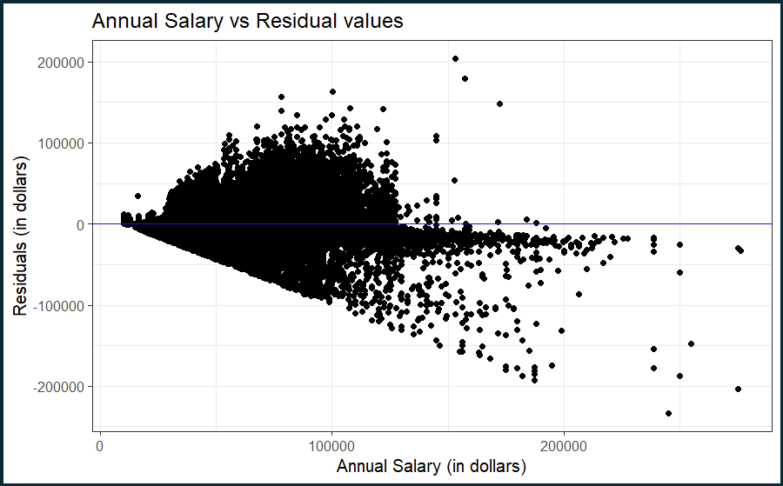
MODEL DIAGNOSTICS : LINEARITY
There is no apparent pattern visible in the residual plot. This means that a linear model is appropriate to describe the relationship between Gross Salary and Annual Salary, that is, the condition of Linearity has been met.

Slide 10
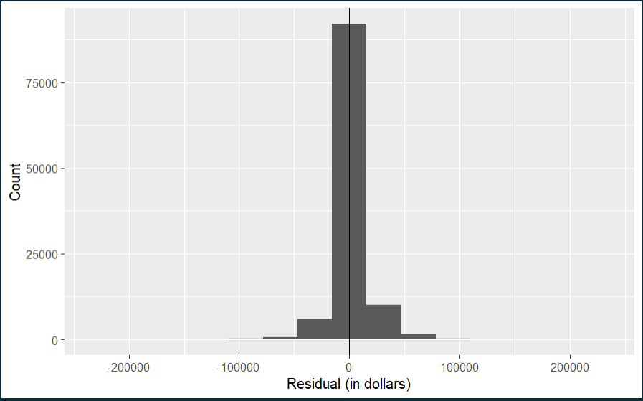
MODEL DIAGNOSTICS : NEARLY NORMAL RESIDUALS
Based on the histogram above, the residual distribution is a unimodal & symmetric and hence, appear to be nearly normal so the condition of nearly normal residuals is met.

Slide 11
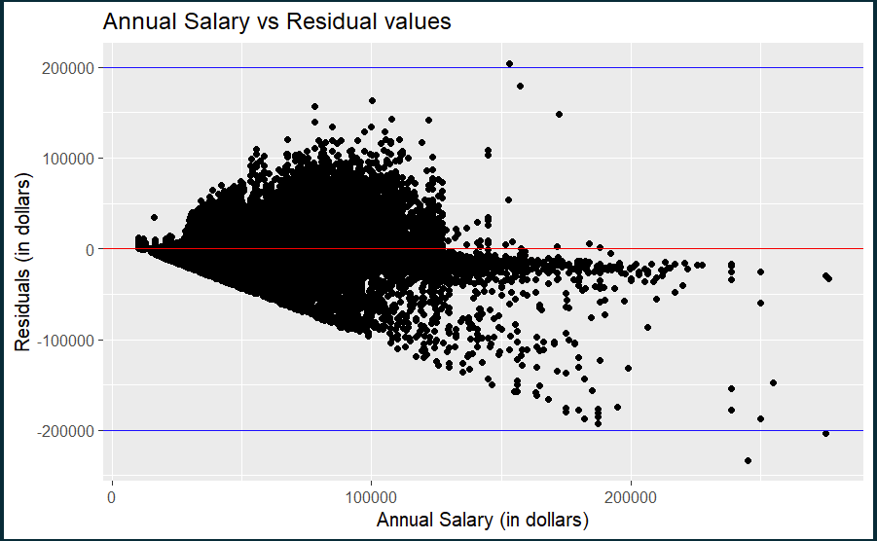
MODEL DIAGNOSTICS : CONSTANT VARIABILITY CHECK
Since the residuals between the two horizontal blue lines appear to be moving funneling out and moving away from 0 with an increase in annual salary and there seems to be an obvious trend that alters the variability, as annual salary increases. Hence, the condition of constant variability has not met.

Slide 12
CONCLUSION
The equation for the linear regression model is:
Gross Salary = -2027 + 1.12 x (Annual Salary)
Based on the results of Model Diagnostics, since all the below three requirements have not been satisfied
LINEARITY
NEARLY NORMAL RESIDUALS
CONSTANT VARIABILITY
we can say that this model is not linear however, it still has a strong relationship which the model display between gross salary and annual salary as per correlation coefficient and R-squared value. Thus, this model can be used to anticipate an employee’s gross salary based on annual salary.

Slide 13
THANK
YOU

